Slide 1
Light Attack Aircraft Proposal
By Joshua Hetzel, Nicolas Giraldo, and Eric Qiu
22 March 2021

Slide 2
Problem
Big Picture: A need exists for an affordable light attack aircraft that can operate from short, austere fields near the front lines. It must provide close air support to ground forces at short notice and complete some missions currently only feasible with attack helicopters
Importance:
Current missions for carrying/deploying weapons to front lines are only feasible with attack helicopters.
A light attack aircraft will allow for increased maneuverability, speed, and mission flexibility.
Fixed cost for aircraft is cheaper than that of helicopters.
Airplanes have fewer moving parts and are easier to maintain than helicopters.
Stakeholders:
U.S. Military: Faster, cheaper, more reliable method of delivering support to front line troops,
leading to a decrease in casualties
U.S. Policymakers/Leadership: Additional tool in which to engage in combat, giving an edge
over enemy troops and increasing likelihood of winning battles

Slide 3
Needs/Goals/Objectives
Needs:
Front line support needs increased maneuverability and speed.
Front line provisions for carrying/deploying weapons are needed at short notice.
Goal: Develop an affordable light attack aircraft that can operate from short, austere fields near the front lines to provide close air support to ground forces at short notice
Objectives:
Austere Field Performance: Takeoff and landing over a 50 ft obstacle on a ≤ 4,000 ft runway when operating from austere fields at density altitude up to 6,000 ft with semi-prepared runways such as grass or dirt surfaces
Service ceiling: ≥ 30,000 ft
Service life: 15,000 hours over 25 years
Assume an entry into service of 2025

Slide 4
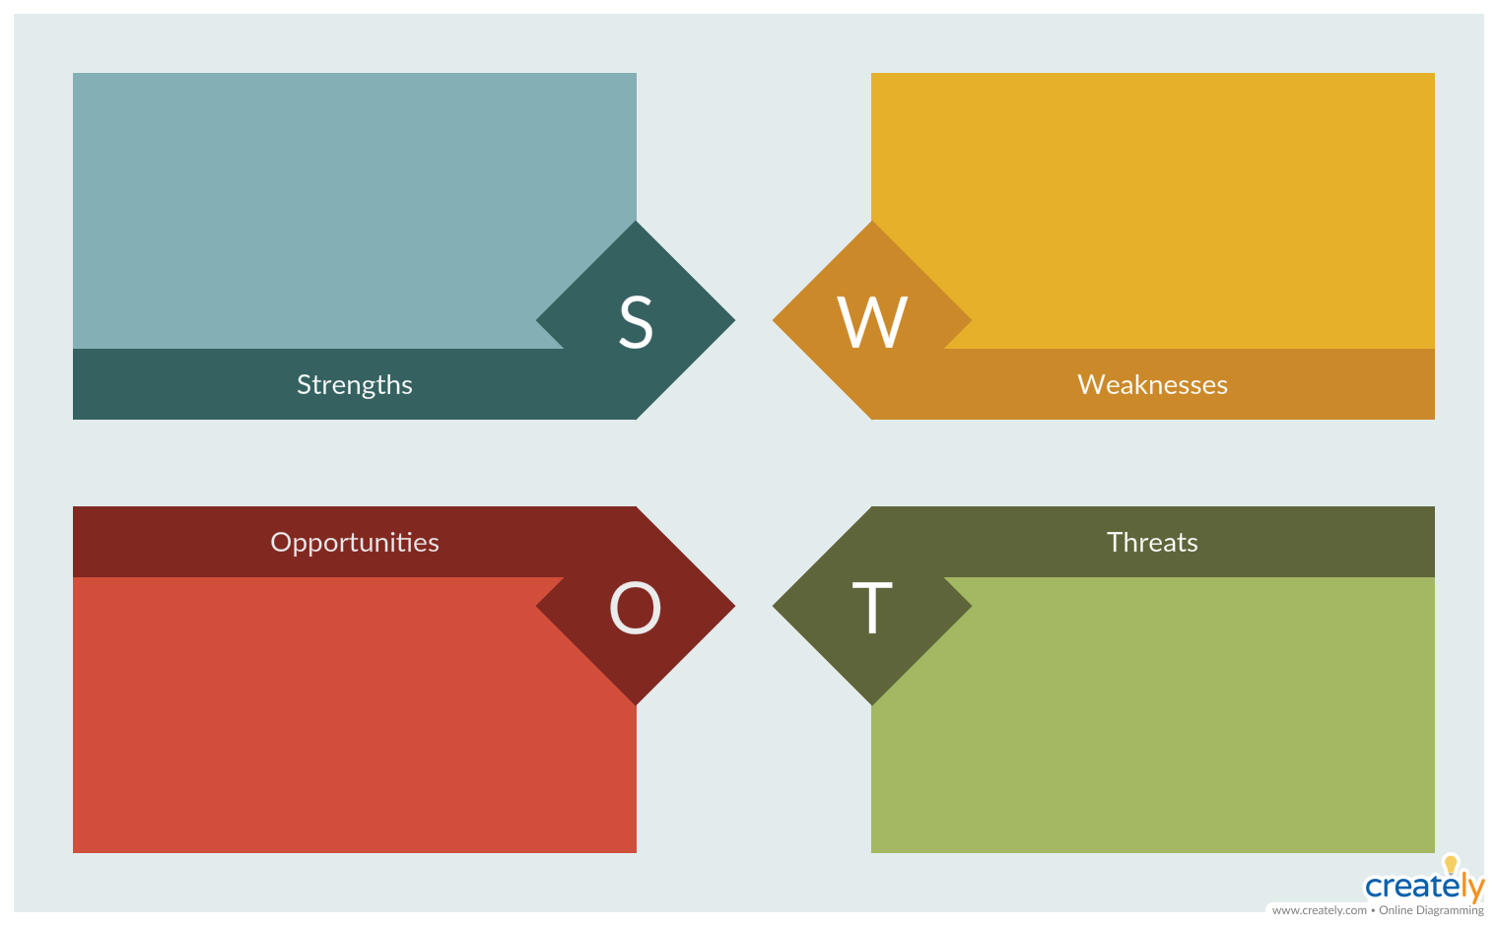
SWOT Analysis
Pilots and maintenance staff need to be properly trained
Lower fixed costs
Easier to maintain
More maneuverability
Advances in materials science
Advances in weapons systems
Advances in GN&C
Enemy gunfire/missiles
Rough storage conditions
Loss of funding with US administration change

Slide 5

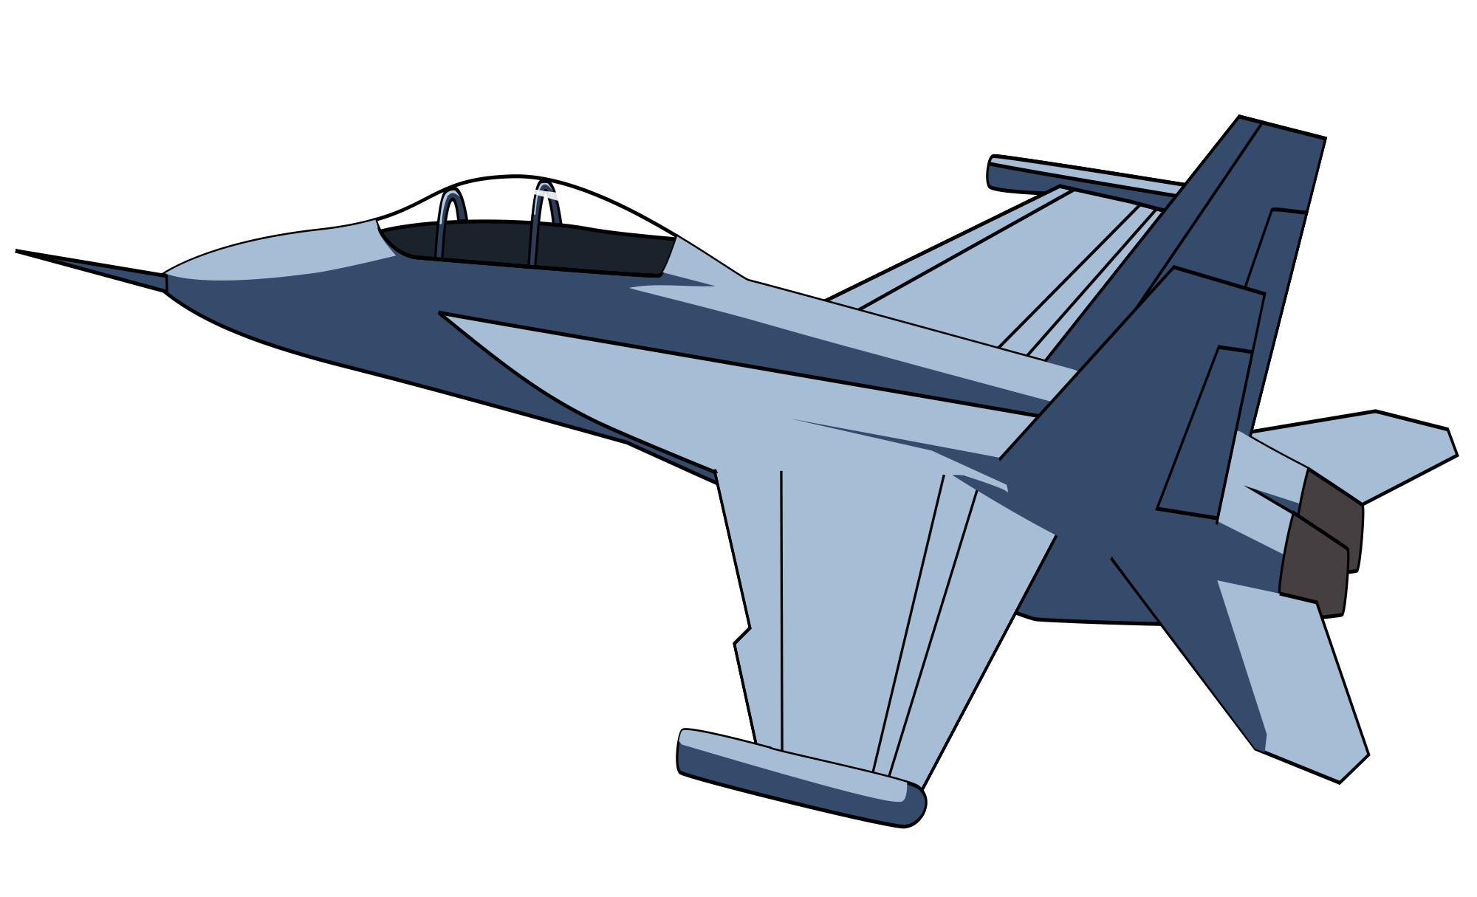


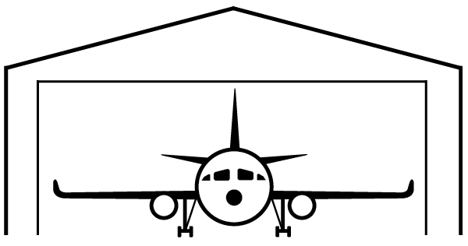
CONOPS
Taxi
Takeoff
Cruise
Engagement
Cruise
Landing
Post-mission
50 ft obstacle
50 ft obstacle
4000 ft runway
4000 ft runway

Slide 6
CONOPS Details
Takeoff/Landing:
Takeoff/Land over 50 ft obstacle on <4000 ft grass/dirt runway
Takeoff/Land from air density altitude of up to 6000 ft
Communicate with air traffic control to coordinate takeoff/landing
Cruise:
Operate at altitude of up to 30,000 ft
Fly from military base to front lines
Communicate with front lines soldiers to determine troop needs
Engagement:
Deploy a variety of weapons including a gatling style gun and laser guided missiles
Engage enemy target from the front lines and provide support to front lines soldiers
Post-Mission:
Maintenance crew inspects and cleans vehicle
Vehicle is refueled and stored in an aircraft hangar

Slide 7
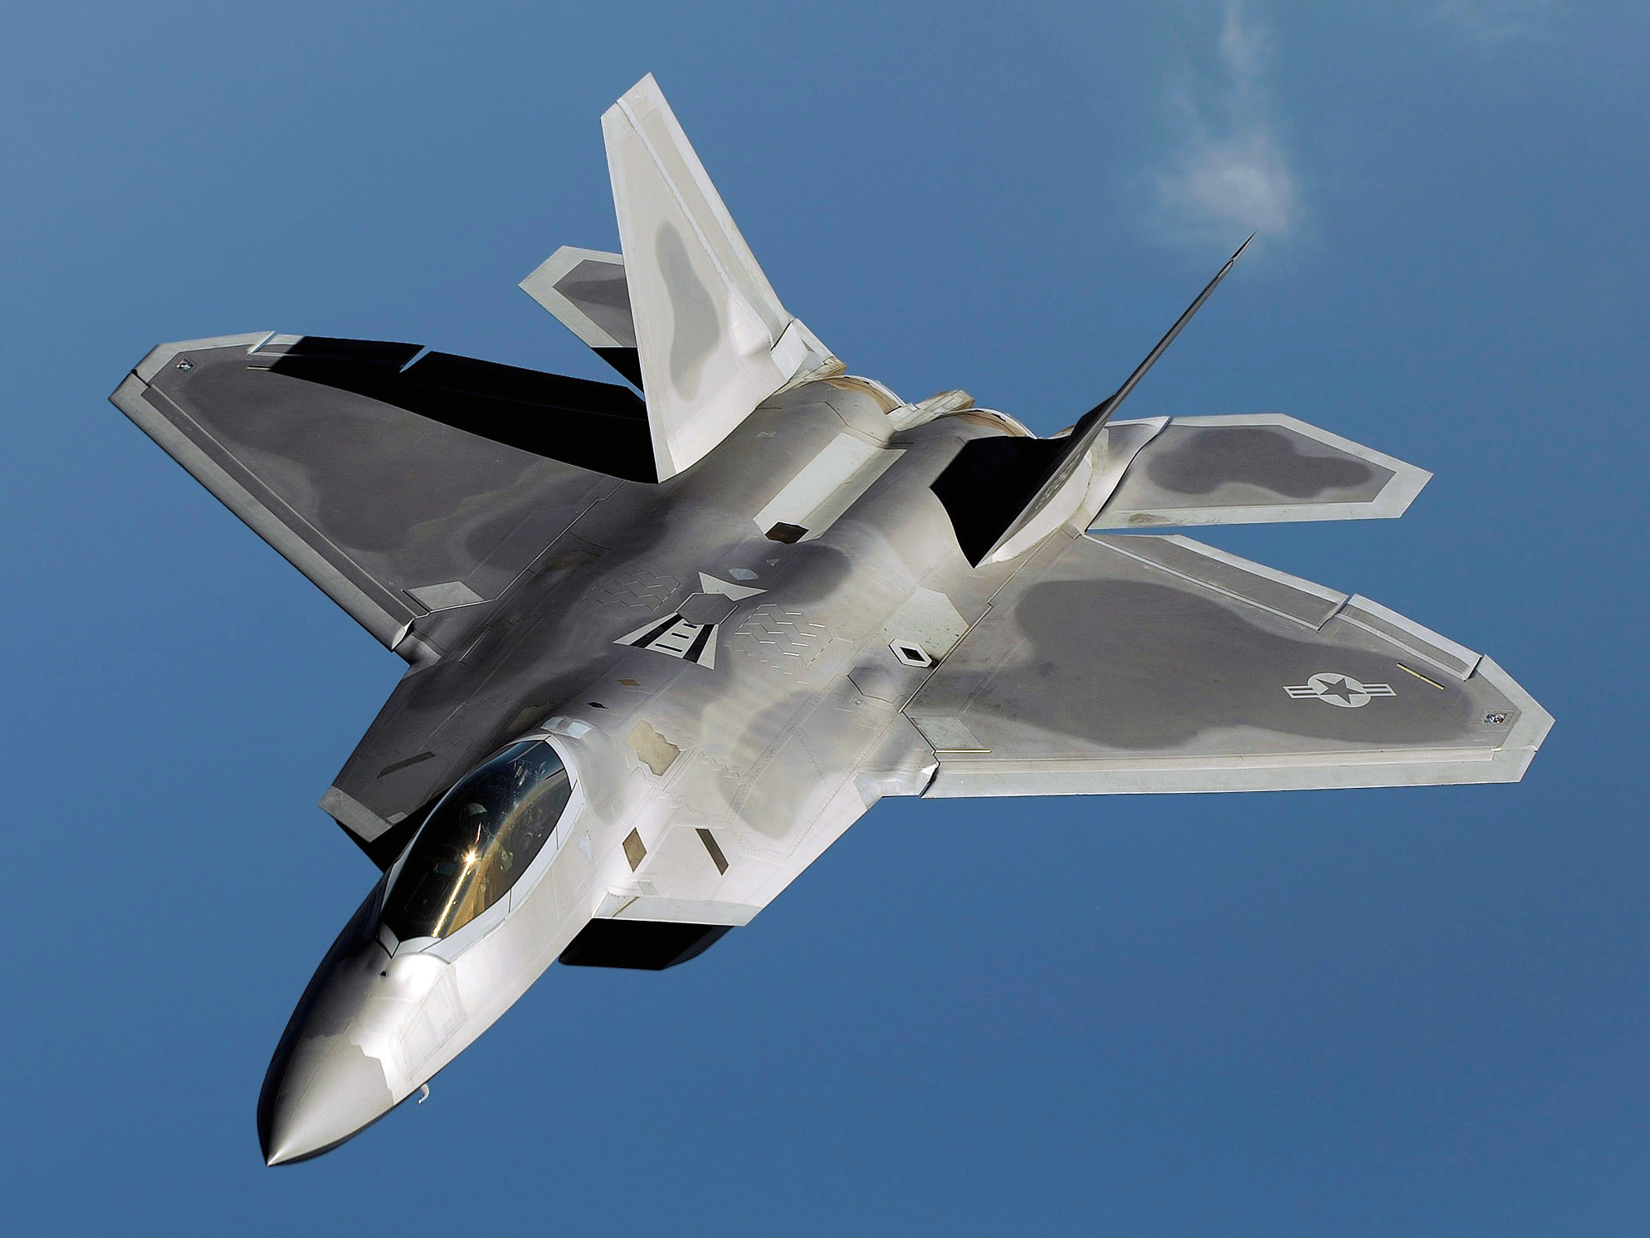
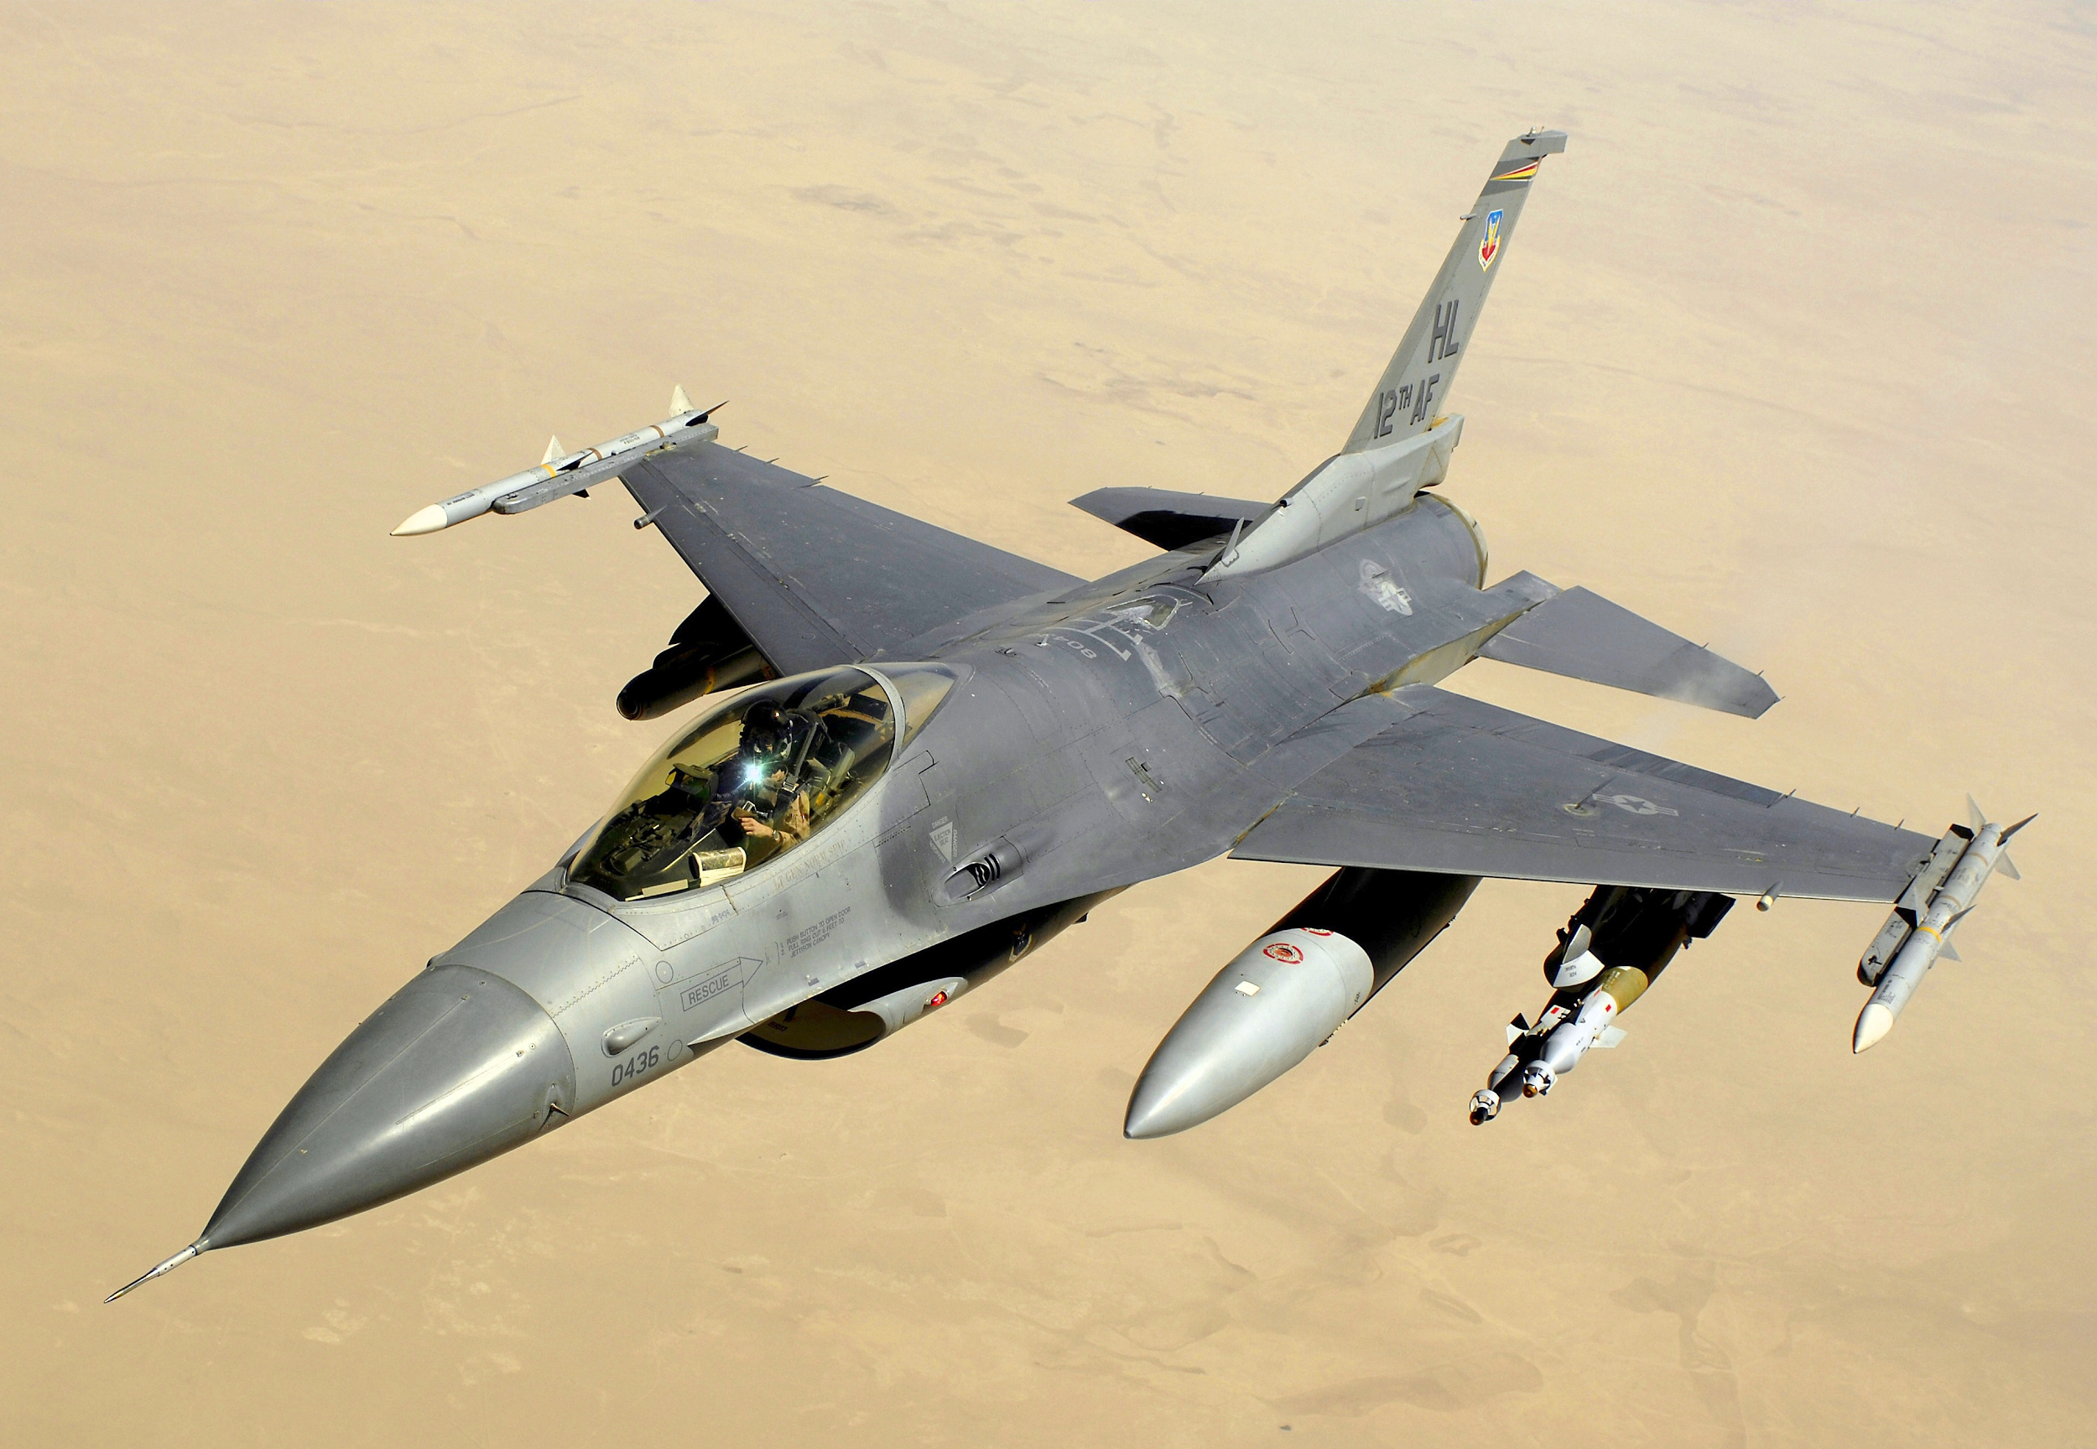
Relevant Concept Examples
F22 Raptor:
Speed: Mach 1.2
Range: 1840 miles
Weapons: 20mm gatling gun + 6 air-to-air missiles
Cost: $67.3 billion
F-16 Fighting Falcon:
Speed: Mach 2
Range: 2622 miles
Weapons: Range of air-to-air missiles
Cost: $18.7 billion

Slide 8
Requirements
Functional:
The system must have the ability to takeoff and land on semi-prepared grass and dirt runways
The system must carry/transport 3000 lbs of armament (including an integrated gun, rail-launched missiles) and 500 lbs of bombs
The system must have zero-zero ejection seats for two crew members
The system must detect other nearby aircraft and display their relative locations to the pilot
The system must communicate to front line units via UHF band
The system must communicate with a home military base via UHF band
The system must communicate with air traffic control for takeoff and landing via UHF band
The system must refuel from the ground
The system must have autopilot capacity during cruise
The system must operate at speeds up to Mach 1

Slide 9
Requirements
Performance:
The system must takeoff and land over a 50 ft obstacle on a runway which is 4000 ft or less in length
The system must be able to takeoff and land on a runway at a density altitude of up to 6000 ft
The system must have a service live of 15,000 hours over 25 years
The system must operate up to altitudes of 30,000 ft
The system must be equipped with a 6-barrel gatling style cannon which fires 20mm exploding shells at a rate of 6000 rounds per minute
The system must be capable of firing rail launched missiles at a range of 0.5 - 10 miles

Slide 10
Requirements
Constraints:
The system must communicate over a frequency in the UHF band
The system must be ready for entry into service no later than December 31, 2025
The system must cost no more than $10 billion
The system must be able to operate in both daytime and nighttime conditions
The system must be able to operate in poor weather conditions, including snow, rain, and fog
The system must operate in temperatures ranging from -75° F to 130° F

Slide 11
Verification of Requirements
The system must be tested in a high speed wind tunnel at a range of speeds from Mach 0-1
The system must test takeoff and landing on both a grass and dirt runway of 4000 ft in length with a 50 ft obstacle at the end
The system must fly to the service ceiling of 30,000 ft
The system must test all weapon components in an empty test range
The system must test the autopilot during cruise conditions for 1 hour
The system must fly to the maximum range in cruise condition
The system must test communications ability in each phase of operations and at the maximum range

Slide 12
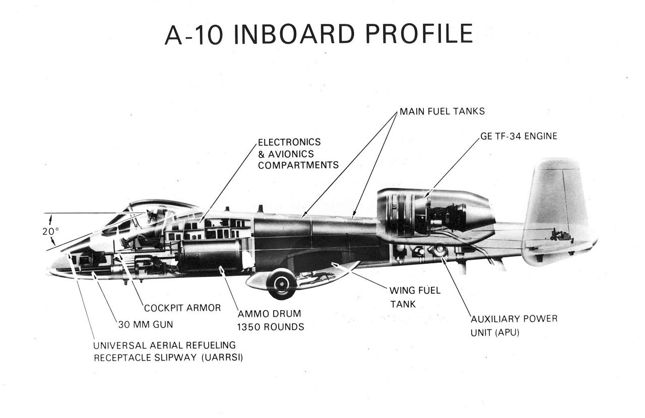
Physical Decomposition
Engines
Electronics
Fuel tanks
Weapons
Cockpit
APU
Fuselage
Wings
Vert/Horiz. Stabilizers
Nose
Armor

Slide 13
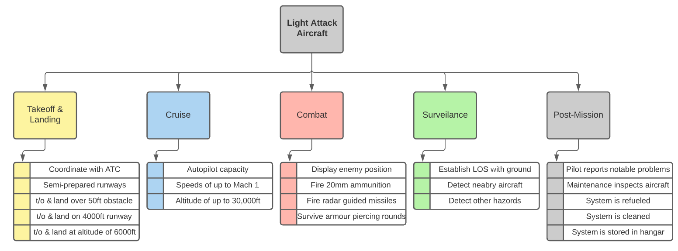
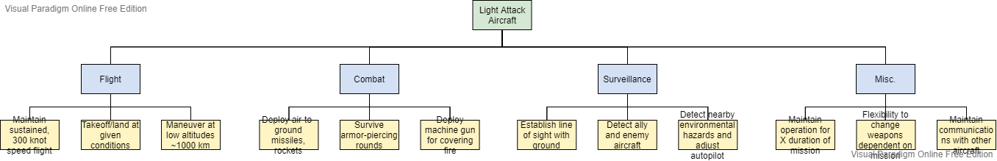
Functional Decomposition + Requirement Flow

Slide 14
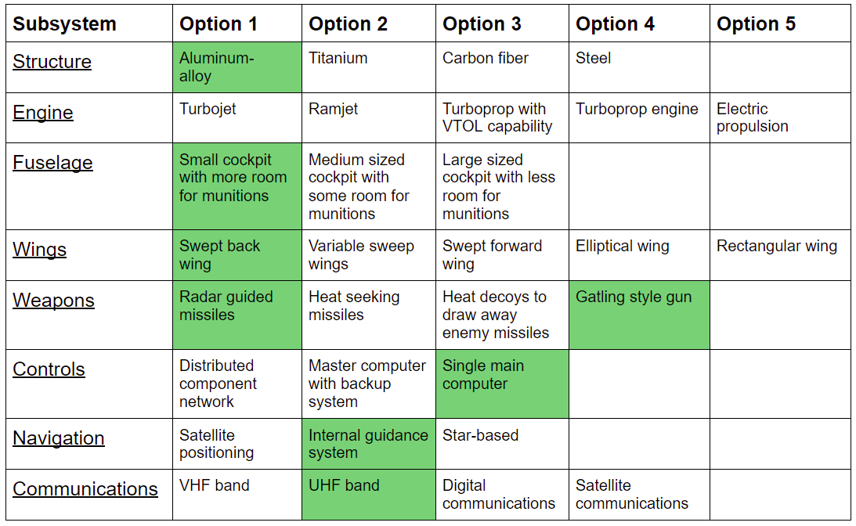
Morphological Matrix

Slide 15
Trade Study
Importance: Determine which engine to use for best performance
Assumptions:
Aircraft does not need to fly at supersonic speeds
Aircraft is operating at altitudes of <30,000 ft
-75° F < Air Temperature < 130° F
Evaluation criteria:
Thrust, Fuel consumption, Weight, Cost, Durability, Ease of maintenance
Trade Study: Since aircraft engines have different specs based on their individual design, a qualitative analysis will provide a better relative result than using quantitative numbers. A Pugh Evaluation Matrix will be used

Slide 16
Pugh Evaluation Matrix
 | Thrust | Fuel Consumption | Weight | Cost | Maintenance | Σ+ | Σ- | Σs
Turbojet | + | - | S | S | S | 1 | 1 | 3
Ramjet | - (only + at high speeds) | + | S | - | + | 2 | 2 | 1
Turbofan | + | + | S | + | - | 3 | 1 | 1
Turboprop w/ VTOL | + | S | - | - | - | 1 | 3 | 1
Electric Propulsion | - | - | - | + | S | 1 | 3 | 1
Decision: Turbofan

Slide 17
Concept Overview/Features
Structure Material: Aluminum alloy skin (light weight) with carbon fiber reinforced polymers (lightweight and strong)
Engine: Turbofan engine, which allows for greater fuel efficiency while still maintaining a large thrust force
Fuselage size: Small fuselage, which allows for room for the engine and a large amount of munitions for front line support
Wing Sweep: Swept-back wing, which reduces critical mach number, allowing for greater air speeds

Slide 18
Concept Overview/Features (cont.)
Weapon Systems: 1 Gatling-style gun firing 20mm explosive rounds, and 4 radar guided missiles
Controls: Single main computer, which decreases the chances of enemy fire damaging a critical component
Navigation: Internal guidance system, decreasing chances of enemy being able to intercept/hack aircraft signals
Communication: UHF band, which is generally standard for military aircraft

Slide 19
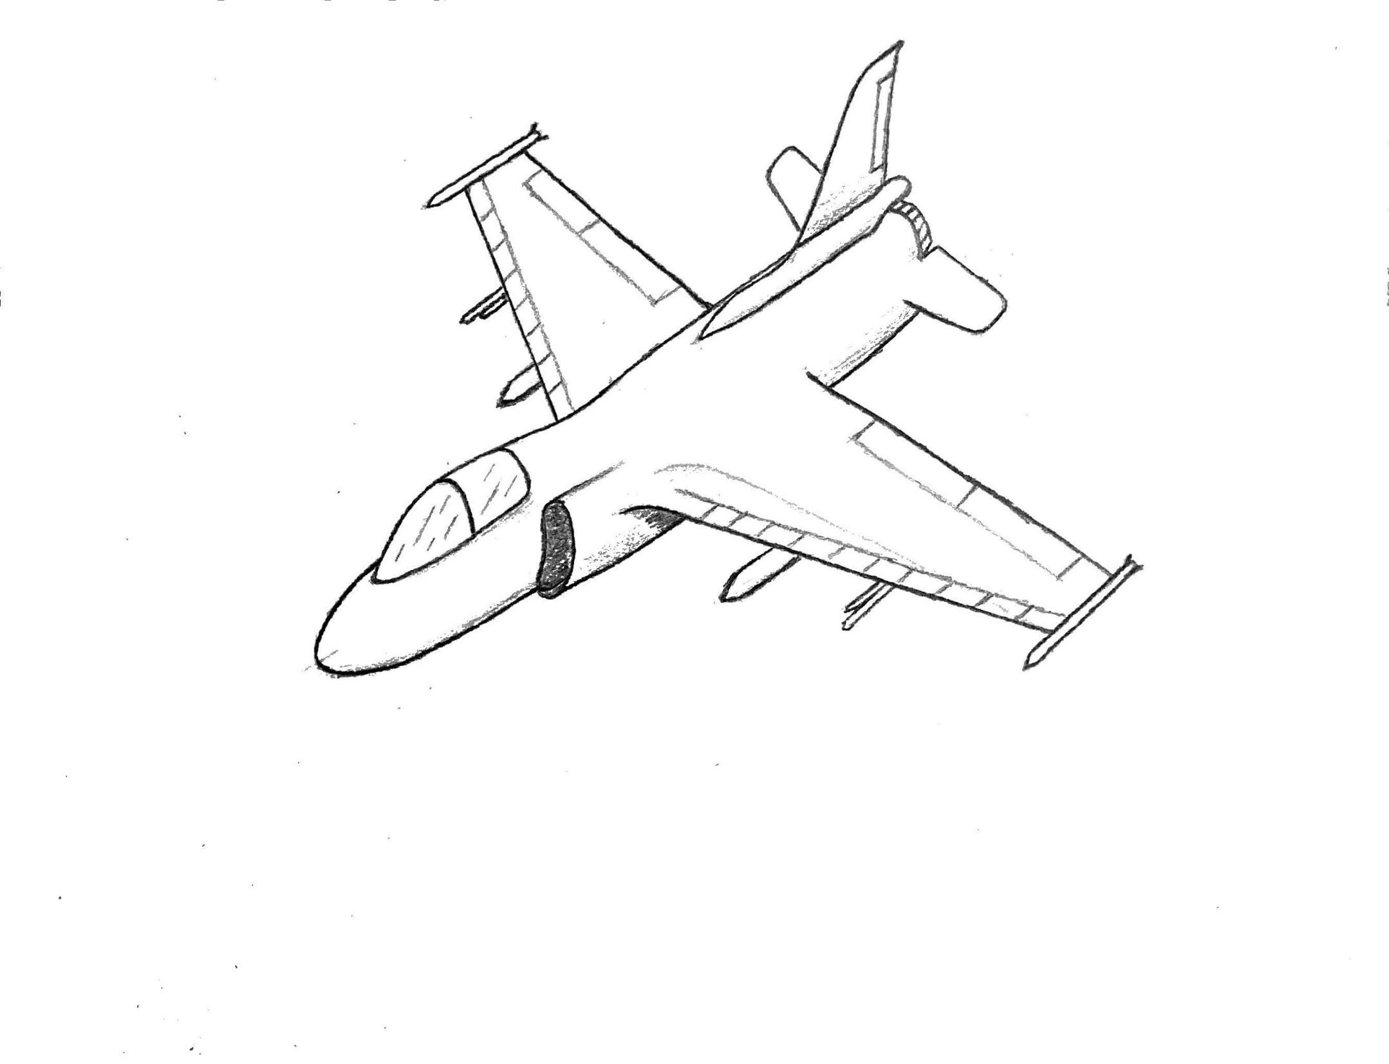
Concept Sketch

Slide 20
Concept Advantages
This concept uses technology that has already been developed/tested
Eliminates research costs
Decreases risk
Decreases development time
Fits a more specific mission profile than other fighter jets
Requirements are more narrow, eliminating expensive (and unnecessary) features, making each unit cheaper to produce
Recommendation: Approve $10 billion of FY 2021 funds for development of light attack aircraft

